Slide 1
PFSD
Review-1

Slide 2
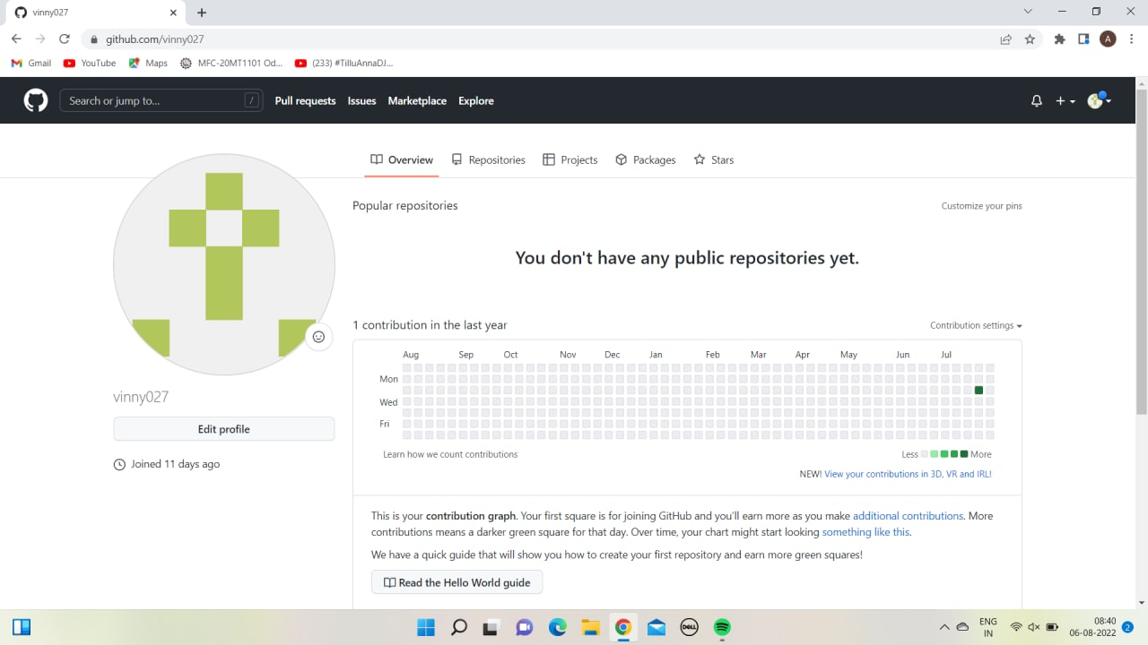
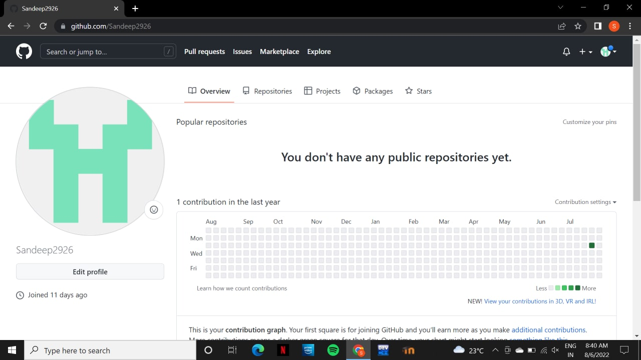
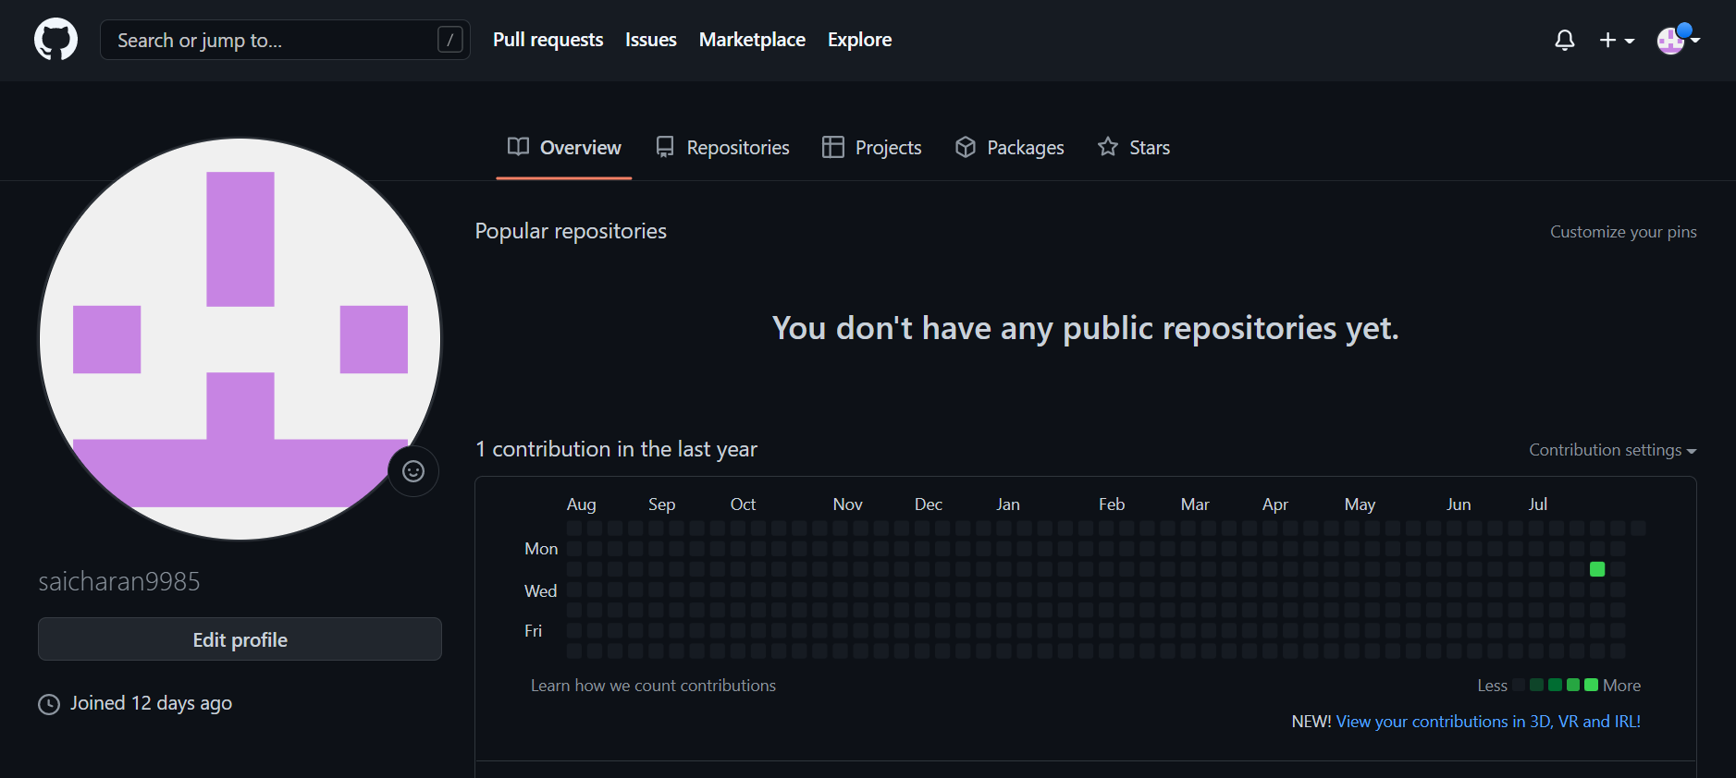
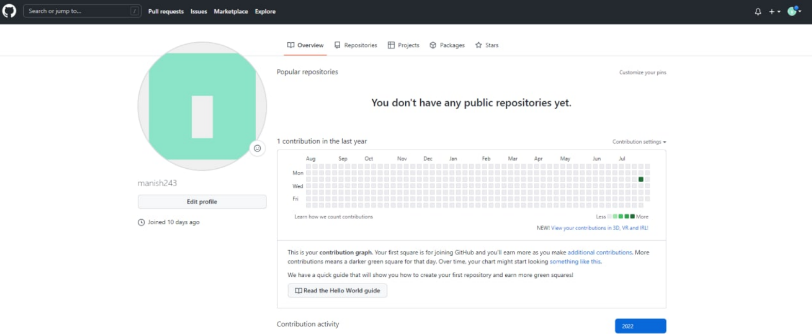
Github Setup:

Slide 3
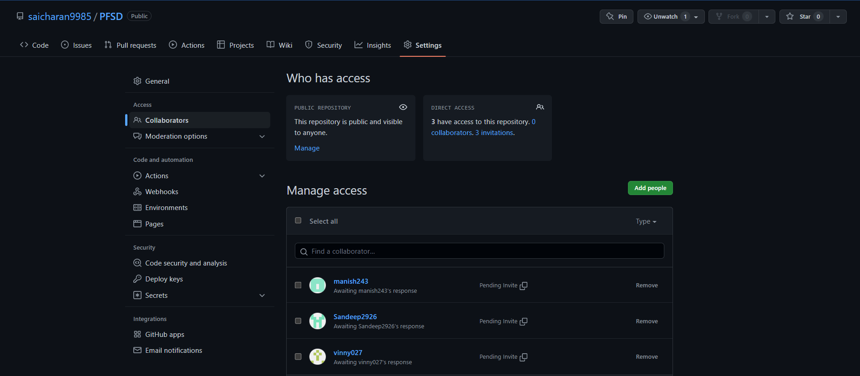
GitHub

Slide 4
Work allocation to team members
R. Naga Maneeshwar (2110030344)-github setup and tools verification.
A .Vinay Kumar(2110030350)- documentation and work allotment.
T. Sandeep(2110030196)-Data set collection and tools setup.
G. Sai Charan (2110030437)-documentation and tools verification.

Slide 5
Data set collection and tools setup
HTML- page layout has been designed in HTML.
CSS-It has been used in all designing parts.
Java Script-All the validation task and animations has been developed here.
Python-All the business logic has been implemented in python.
MySQL- This database has been used as database for the project.
Django-This has been used for the framework.

Slide 6
Configurations for this project :
Windows: This project can be configured in windows easily need to install Python, Django , PIP.
Linux: we can run this project on all versions of operating systems.
Mac :we can run this project on operating systems also.

